Slide 1
Chapter 7: Natural selection and speciation

Slide 2
Variation in populations
Evolution is the scientific explanation for the mechanisms that drive species to change (adapt) over time.
Evolution occurs in response to pressures, such as environmental changes or opportunities.
The basis of evolution is that over time, organisms acquire enough variation that they become a new species.

Slide 3
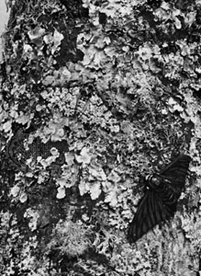
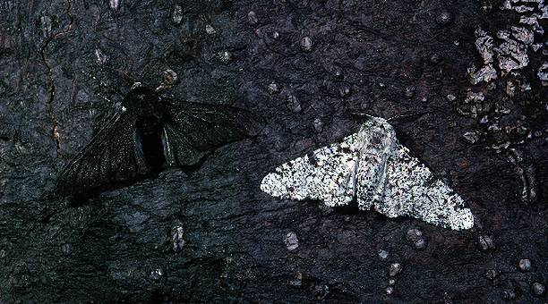
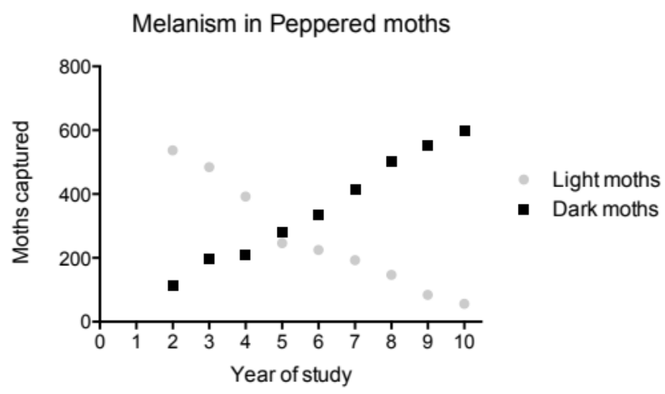
Adaptation to environmental pressures drives evolution
Prior to the industrial revolution, the majority of Peppered moths were light and speckled, which camouflaged them while they rested on lichen-covered tree trunks.
http://www.britannica.com/EBchecked/media/138655/Against-the-background-of-a-lichen-covered-oak-tree-a
The industrial revolution caused soot deposition on tree trunks, making light moths more susceptible to predation.

Slide 4
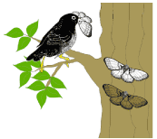
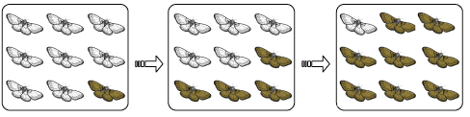
Variation in populations
The key to the Peppered moth example is that dark-coloured moths already existed within the Peppered moth population.
Following industrialisation and blackening of tree branches, predators could more easily find the light coloured moths, and so dark moths survived better.
More of the dark moths could contribute to the next generation, passing on their genes for dark wing and body colour.
http://cyberbridge.mcb.harvard.edu/evolution_1.html

Slide 5
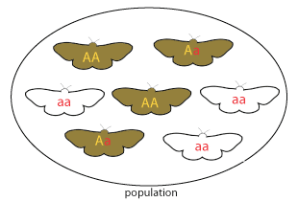
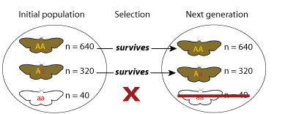
Variation in populations
The allele for dark pigmentation in moths is A and is dominant over the allele for light colouring, a.
The moth population contained some individuals with the dark phenotype, carrying the A allele.
During the peak of the Industrial Revolution, the A allele became more common in subsequent generations.
This is an example of natural selection.

Slide 6
Gene pools
Variation in populations
Natural selection acts on alleles, which are inheritable.
The total collection of alleles that exists within a population is called its gene pool.
In biological terms, a population is a group of individuals of the same species, which live in the same geographic area and readily interbreed to produce fertile offspring.
Members of a population belong to the same gene pool.
Variation in a population is restricted to what’s already present in the gene pool.
But new variation can arise by mutation.

Slide 7
Allele frequencies
Variation in populations
For variation to occur in phenotypes, more than one allele of a gene must exist.
Phenotypes that vary due to different alleles are called polymorphisms, from ‘many forms’.
The frequency of alleles in a population changes in response to:
mutation of an allele, introducing a new allele to the gene pool
immigration into the population
emigration out of the population
different rates of reproduction of different individuals

Slide 8
Sources of variation
Variation in populations
Mutation of an existing allele can produce a new allele.
Alleles introduced this way are often recessive and stay hidden, unless individuals breed with related individuals.
Recessive alleles are often deleterious, but are also an important source of biological variation.

Slide 9
Sources of variation
Variation in populations
Genetic drift occurs because alleles are inherited randomly from parents.
It describes changes to the gene pool that occur by chance and are not driven by selection pressures. These changes can occur:
-Because allele frequencies are not the same from generation to generation – e.g. if everyone in the room tossed a coin 10 times – would everyone get 5 heads and 5 tails?
  For example, an allele may not be passed on to the next generation and, in a small population, this may mean that it is soon lost from the gene pool entirely.
Because a change event may kill individuals non-selectively, altering the allele frequencies in the gene pool

Slide 10
Sources of variation
Variation in populations
The bottleneck effect is an example of genetic drift. It occurs when a population is drastically reduced in size, for example by a natural disaster.
The alleles present in the surviving members of the population may not be representative of the original population.
The gene pool of the new population is not representative of the original gene pool
A population - circles represent individuals/alleles
Surviving individuals
An event causes loss of most of the population

Slide 11
Sources of variation
Variation in populations
The founder effect occurs when a small number of individuals found a new population.
The alleles present in the founding members of the new population may not be representative of the original population.
The gene pool of the new population is not representative of the original pool
Emigration of a group of individuals

Slide 12
Sources of variation
Variation in populations
In this example of the founder effect, the group of individuals that emigrates to found a new population also removes some alleles from the gene pool, resulting in genetic drift in the original population
The blue and orange alleles have become less frequent

Slide 13
The mechanism of adaptive evolution
Natural selection
Natural selection is the driving force for adaptive evolution.
It is the only mechanism that can lead to new species that are better suited to their environment.
Natural selection is therefore the only mechanism that can lead to adaptive evolution.

Slide 14
Principals of natural selection
Natural selection
Individuals within a population show variation in their phenotypes.
Much of this variation is due to different alleles and is therefore inheritable.
Competition for resources and territories means there is a struggle for existence. More offspring are born than can survive and reproduce.
Some individuals have traits that make them more suited to their environment than others.
      These individuals are better able to survive and reproduce (this is sometimes called ‘fitness’).
      These individuals are better able to pass their alleles on to their offspring.
      The traits that enabled these individuals to better survive and reproduce are selected for.

Slide 15
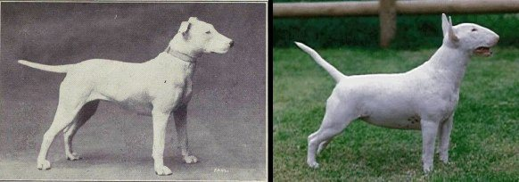
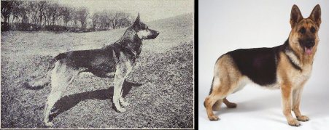
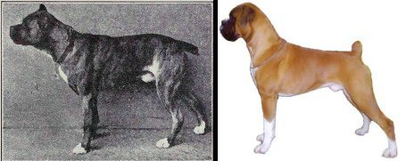
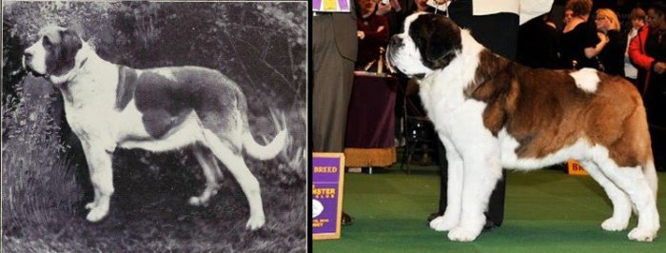
Artificial selection
Natural selection
Artificial selection occurs when humans select individuals with traits they desire to become the breeding stock.
It relies upon human intervention.

Slide 16
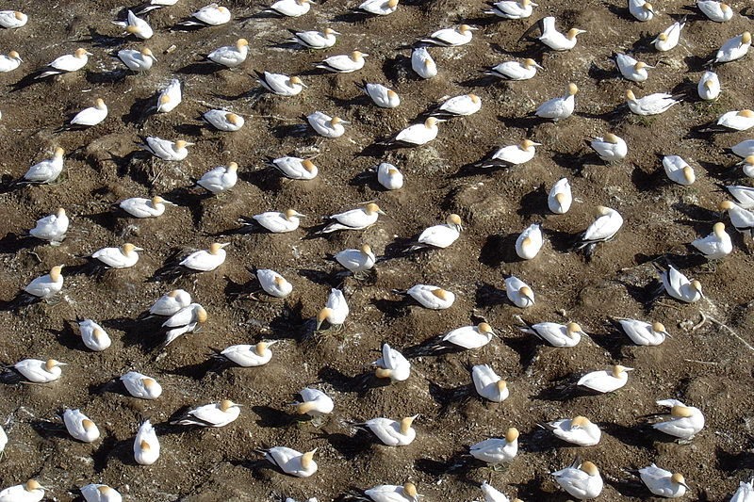
Selection pressures
Natural selection
Selection pressures are factors that influence the survival of an individual, population or species.
Examples include:
Competition for food, water and territories
    Between individuals within a species
    Between different species
Nesting gannets in New Zealand

Slide 17
Selection pressures
Natural selection
Thomas Malthus was a political economist who was concerned about the poor standard of living in the late 18th century.
He blamed the situation on overproduction of young, a lack of resources to keep up with the increasing population, and irresponsibility of lower classes.
Charles Darwin wrote the following in his autobiography (1876).
"In October 1838, that is, fifteen months after I had begun my systematic inquiry, I happened to read for amusement Malthus on Population, and being well prepared to appreciate the struggle for existence which everywhere goes on from long- continued observation of the habits of animals and plants, it at once struck me that under these circumstances favourable variations would tend to be preserved, and unfavourable ones to be destroyed. The results of this would be the formation of a new species. Here, then I had at last got a theory by which to work”.

Slide 18
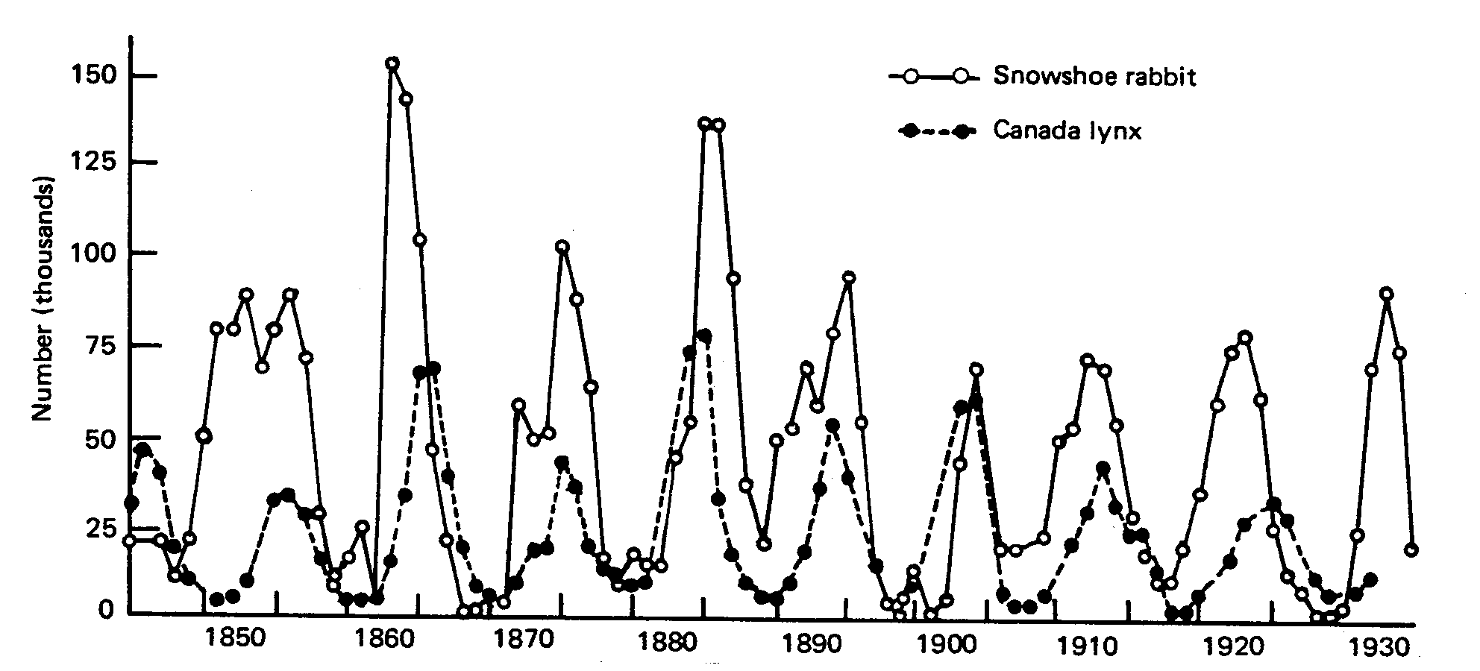
Selection pressures
Natural selection
Selection pressures are factors that influence the survival of an individual, population or species.
Examples include:
Predator/prey relationships
From the Hudson’s Bay Company fur purchase records

Slide 19
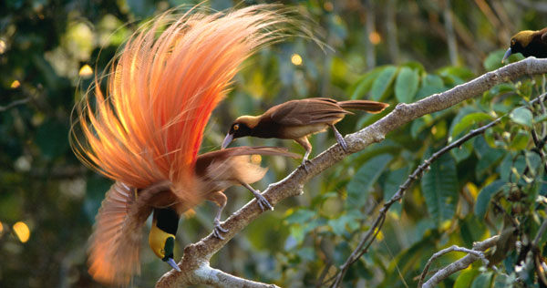
Selection pressures
Natural selection
Selection pressures are factors that influence the survival of an individual, population or species.
Examples include:
Competition for mates (sexual selection)
Phil Savoie, Nature Picture Library

Slide 20
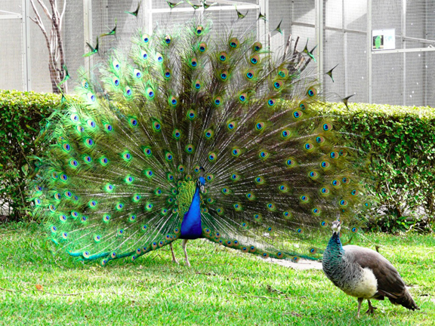
Selection pressures
Natural selection
Sexual selection occurs when individuals with particular traits are more likely to be successful than other individuals in finding a mate.
It can lead to spectacular results and can produce sexual dimorphism, where males and females of a species have different forms.

Slide 21
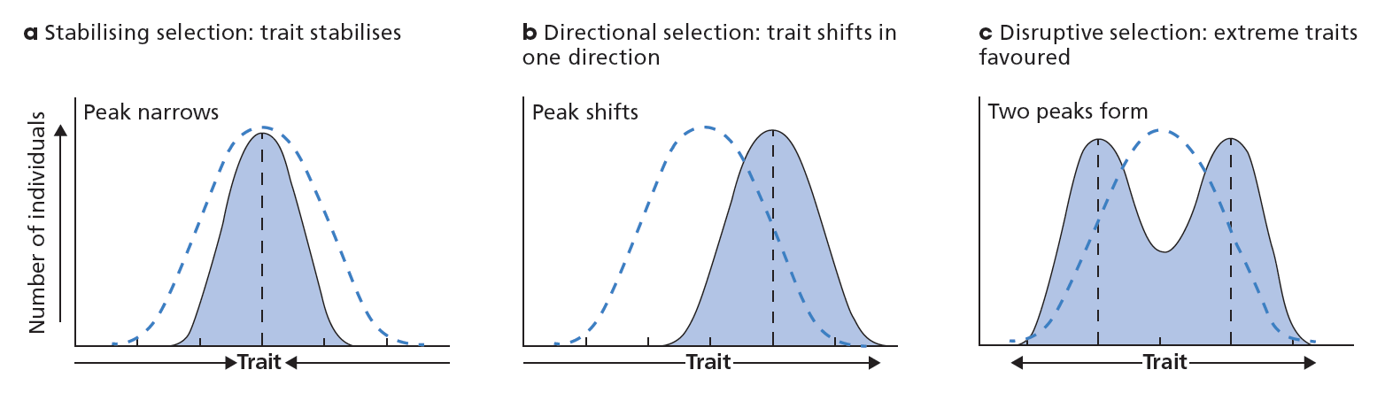
Natural selection
Natural selection can be stabilizing, directional or disruptive.
Figure 7.14

Slide 22
Microevolution
Evolution
Natural selection causes the allele frequencies to change in a population.
This process is called microevolution.
Microevolution is any change in the gene pool of a population over time.
The idea of microevolution puts the spotlight of evolutionary theory on the genetic makeup of populations.

Slide 23
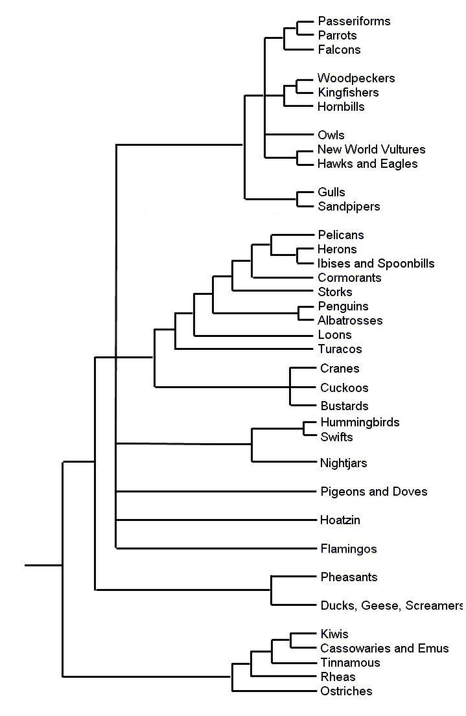
Macroevolution
Evolution
Major evolutionary changes above the species level are referred to as macroevolution.
It usually refers to more than one gene pool, or more than one species
Microevolution refers to small changes within a gene pool, ie a population
E.g. Mornington Peninsula hummingbirds
The time scale of macroevolution might be quite different to that of microevolution.
Macroevolution refers to evolutionary change affecting several gene pools

Slide 24
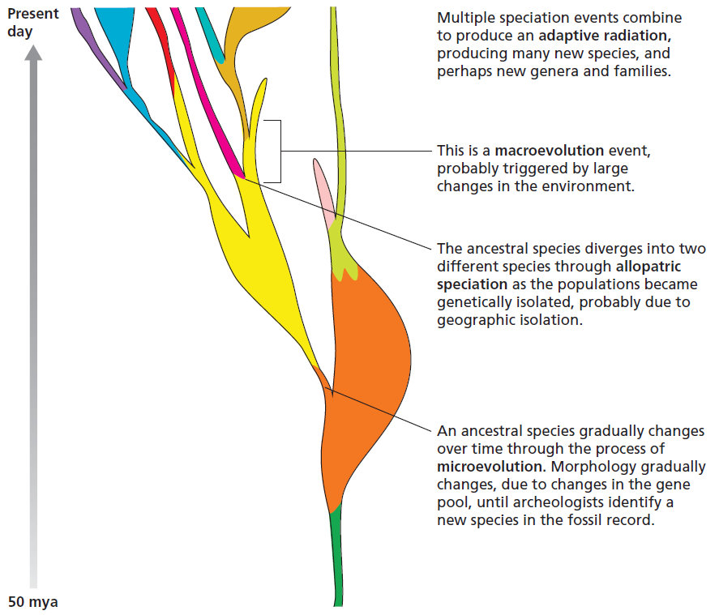
Macroevolution
Evolution
This figure shows some examples of macroevolution events, which include mass extinctions and adaptive radiations.
Figure 7.15

Slide 25
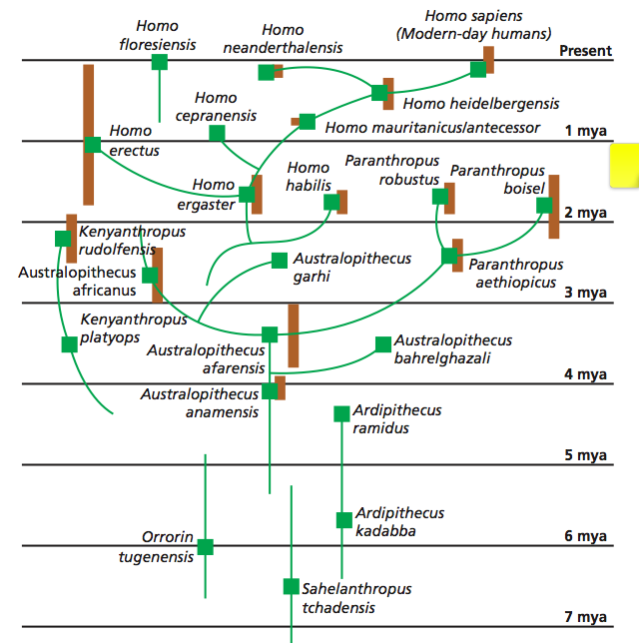
Macroevolution
Evolution
The human evolutionary story
Are humans still evolving?
Adaptive radiation probably due to climate change
Figure 7.10

Slide 26
A diversity of species
Speciation
Before Darwin’s theory of evolution by natural selection, it was generally believed that species were immutable, or unchanging.
While some species change very little over time, the fossil record shows us that others have changed significantly.
The appearance of new species is termed speciation.

Slide 27
Review
Speciation
Natural selection causes microevolution within a gene pool.
Eventually a population accumulates enough changes that a new species can be identified and speciation has occurred.
Sometimes several speciation events occur and lead to a collection of new species or even higher classification groups. This is macroevolution.
Evolution is also marked by extinction.

Slide 28
Definitions of speciation
Speciation
Speciation, or the appearance of a new species, is marked by a clear biological boundary:
The new species cannot successfully reproduce with the original species.
This is called reproductive isolation and is the basis of the biological species concept.
For species that are now extinct, this concept cannot be tested, so the morphological species concept is used instead.
This identifies species based on their morphological and physiological characteristics.
The morphological species concept is limited by what can be observed in the fossil record.

Slide 29
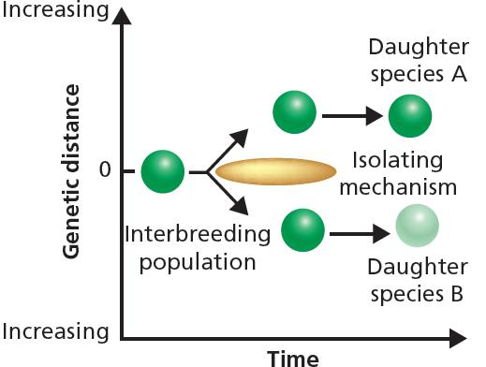
Mechanisms of speciation
Speciation
Speciation relies upon reproductive isolation, which prevents the gene pools of the new species from mixing with that of the original species.
Isolating mechanisms separate the two groups. These can be:
Pre-reproductive
Geographical features (seas, mountains, distance, habitat)
Temporal mechanisms (different breeding seasons or time of day)
Behavioural mechanisms (different courtship patterns; e.g. mating calls)
Morphological mechanisms (different reproductive structures)
Figure 7.20

Slide 30
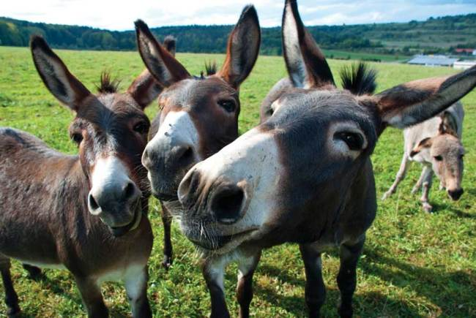
Mechanisms of speciation
Speciation
Isolating mechanisms can also be:
Post-reproductive
i.e. don’t prevent mating but prevent formation of viable, fertile offspring
Gamete mortality (gametes do not survive after mating)
Zygote mortality (zygote forms but does not survive)
Hybrid sterility (adult offspring develop but cannot produce viable gametes)
- Hybrid sterility is not often a reproductive isolating mechanism in plants, where polyploidy is common.
A mule is a sterile hybrid offspring from a mating between a male donkey and a female horse.

Slide 31
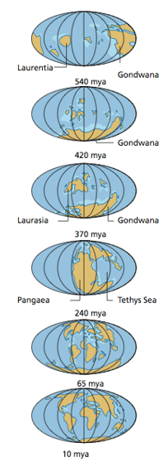
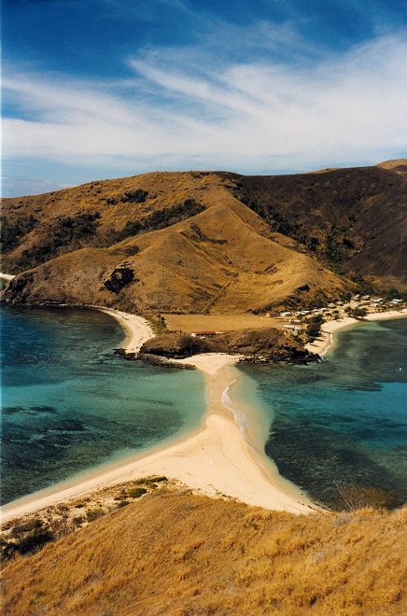
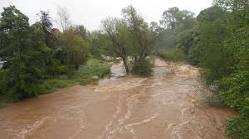
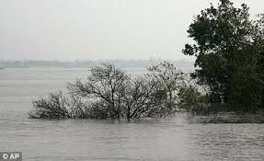
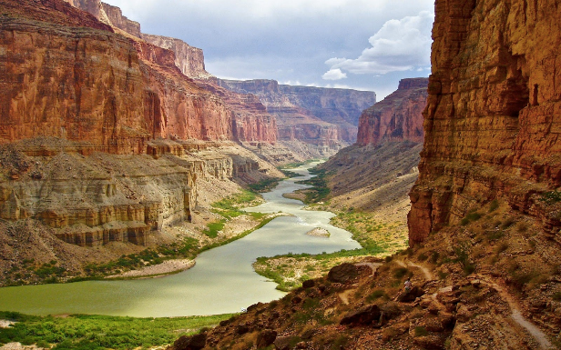
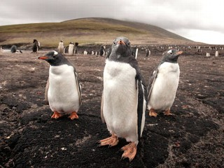
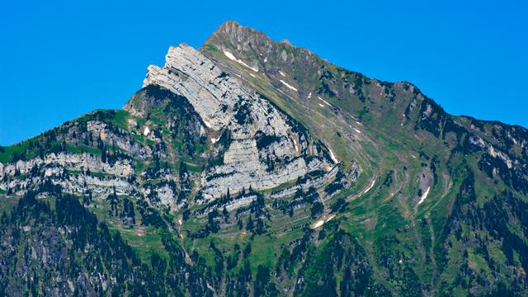
Mechanisms of speciation
Speciation
Allopatric speciation occurs as populations are geographically isolated.
Continental drift
Water
Land
Rising sea level
Canyons
Climate change
Mountains

Slide 32
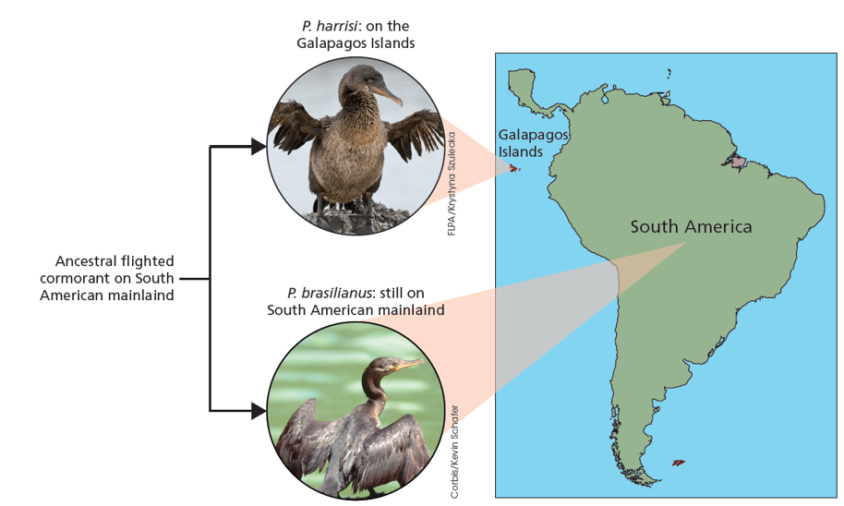
Mechanisms of speciation
Speciation
Allopatric speciation occurred when populations established on the Galapagos Islands.
Figure 7.22

Slide 33
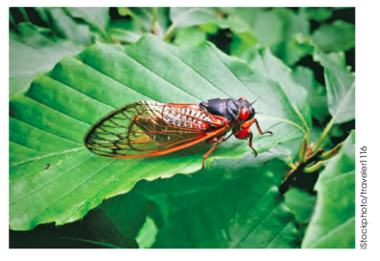
Mechanisms of speciation
Speciation
Sympatric speciation refers to the evolution of two or more new species within the same place.
For example, some cicadas hatch out and reproduce once every 17 years and others hatch every 13 years. This behaviour may have been the reproductive isolating mechanism that led to their sympatric speciation.
Figure 7.21

Slide 34
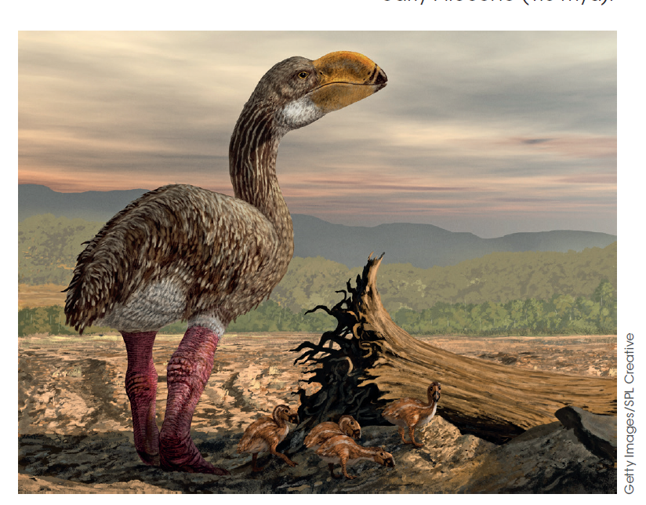
Mass extinctions
Extinction
Extinction occurs quite rarely but there have been periods when the rate of extinction has been quite high. These are mass extinctions.
We appear to be in the midst of the sixth mass extinction, which began around 50,000 years ago, when modern humans spread out of Africa.
This coincided with the extinction of several species of megafauna.
Figure 7.23

Slide 35
Preventing extinction
Extinction
Preservation of genetic diversity is key to preventing extinction.
Having a larger gene pool means having more alleles to draw upon to face the pressures of natural selection.
Conservation reserves protect endangered species from human influence and predation.
It is difficult to know how large reserves need to be to be effective.
Does there need to be a single large or several small (SLOSS) reserves?
What population size is required for long-term survival?
Wildlife corridors can link otherwise isolated conservation areas and allow animals to move to new areas when resources become scarce.

